Slide 1
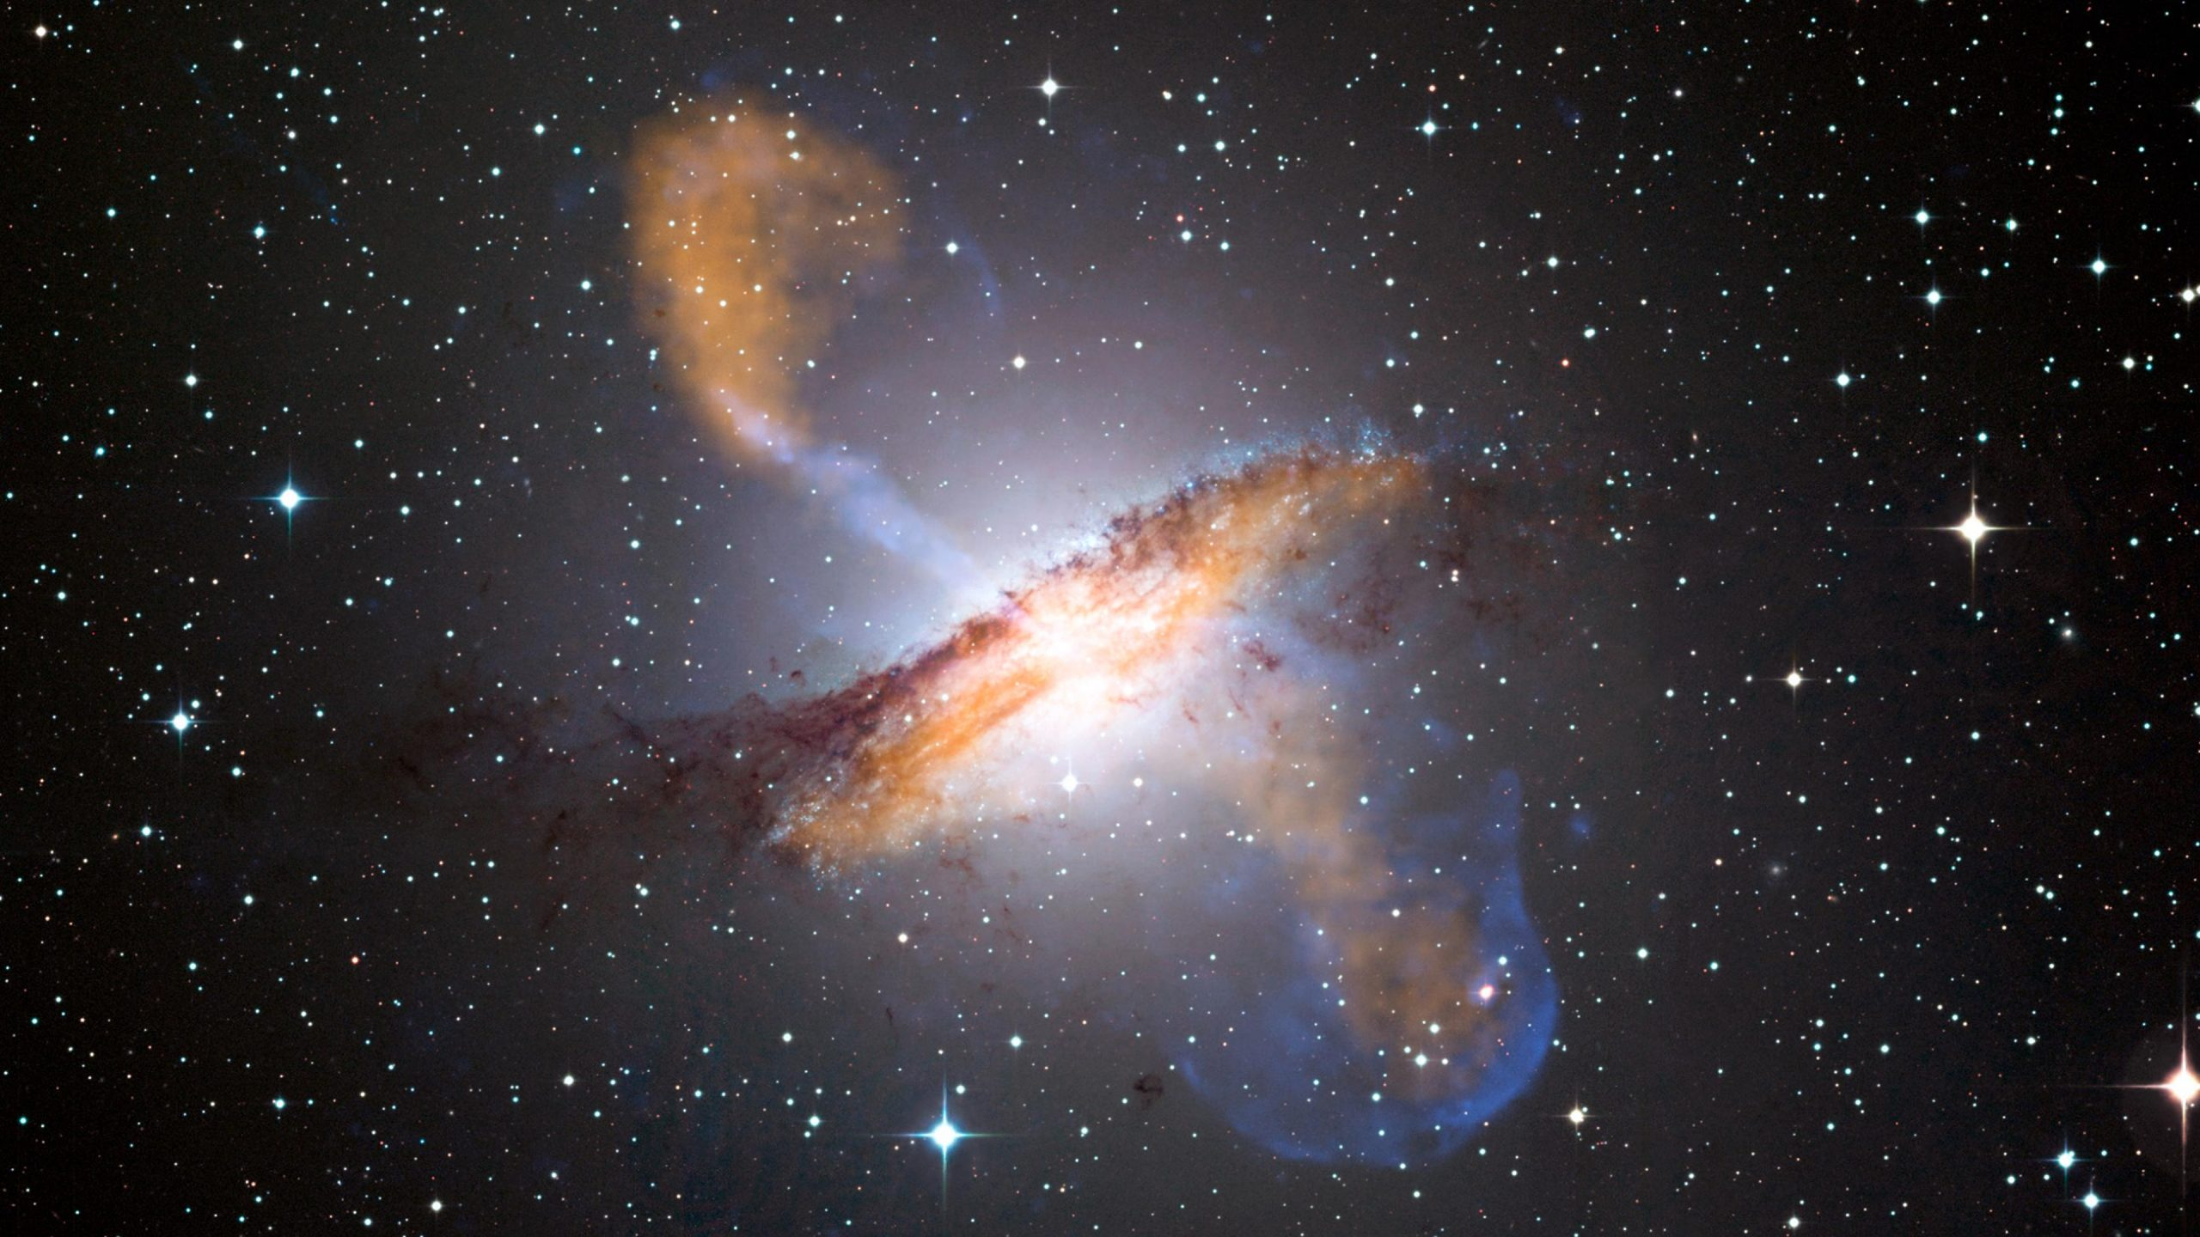
Galaxies and Universe Term project 2022
Team C

Slide 2
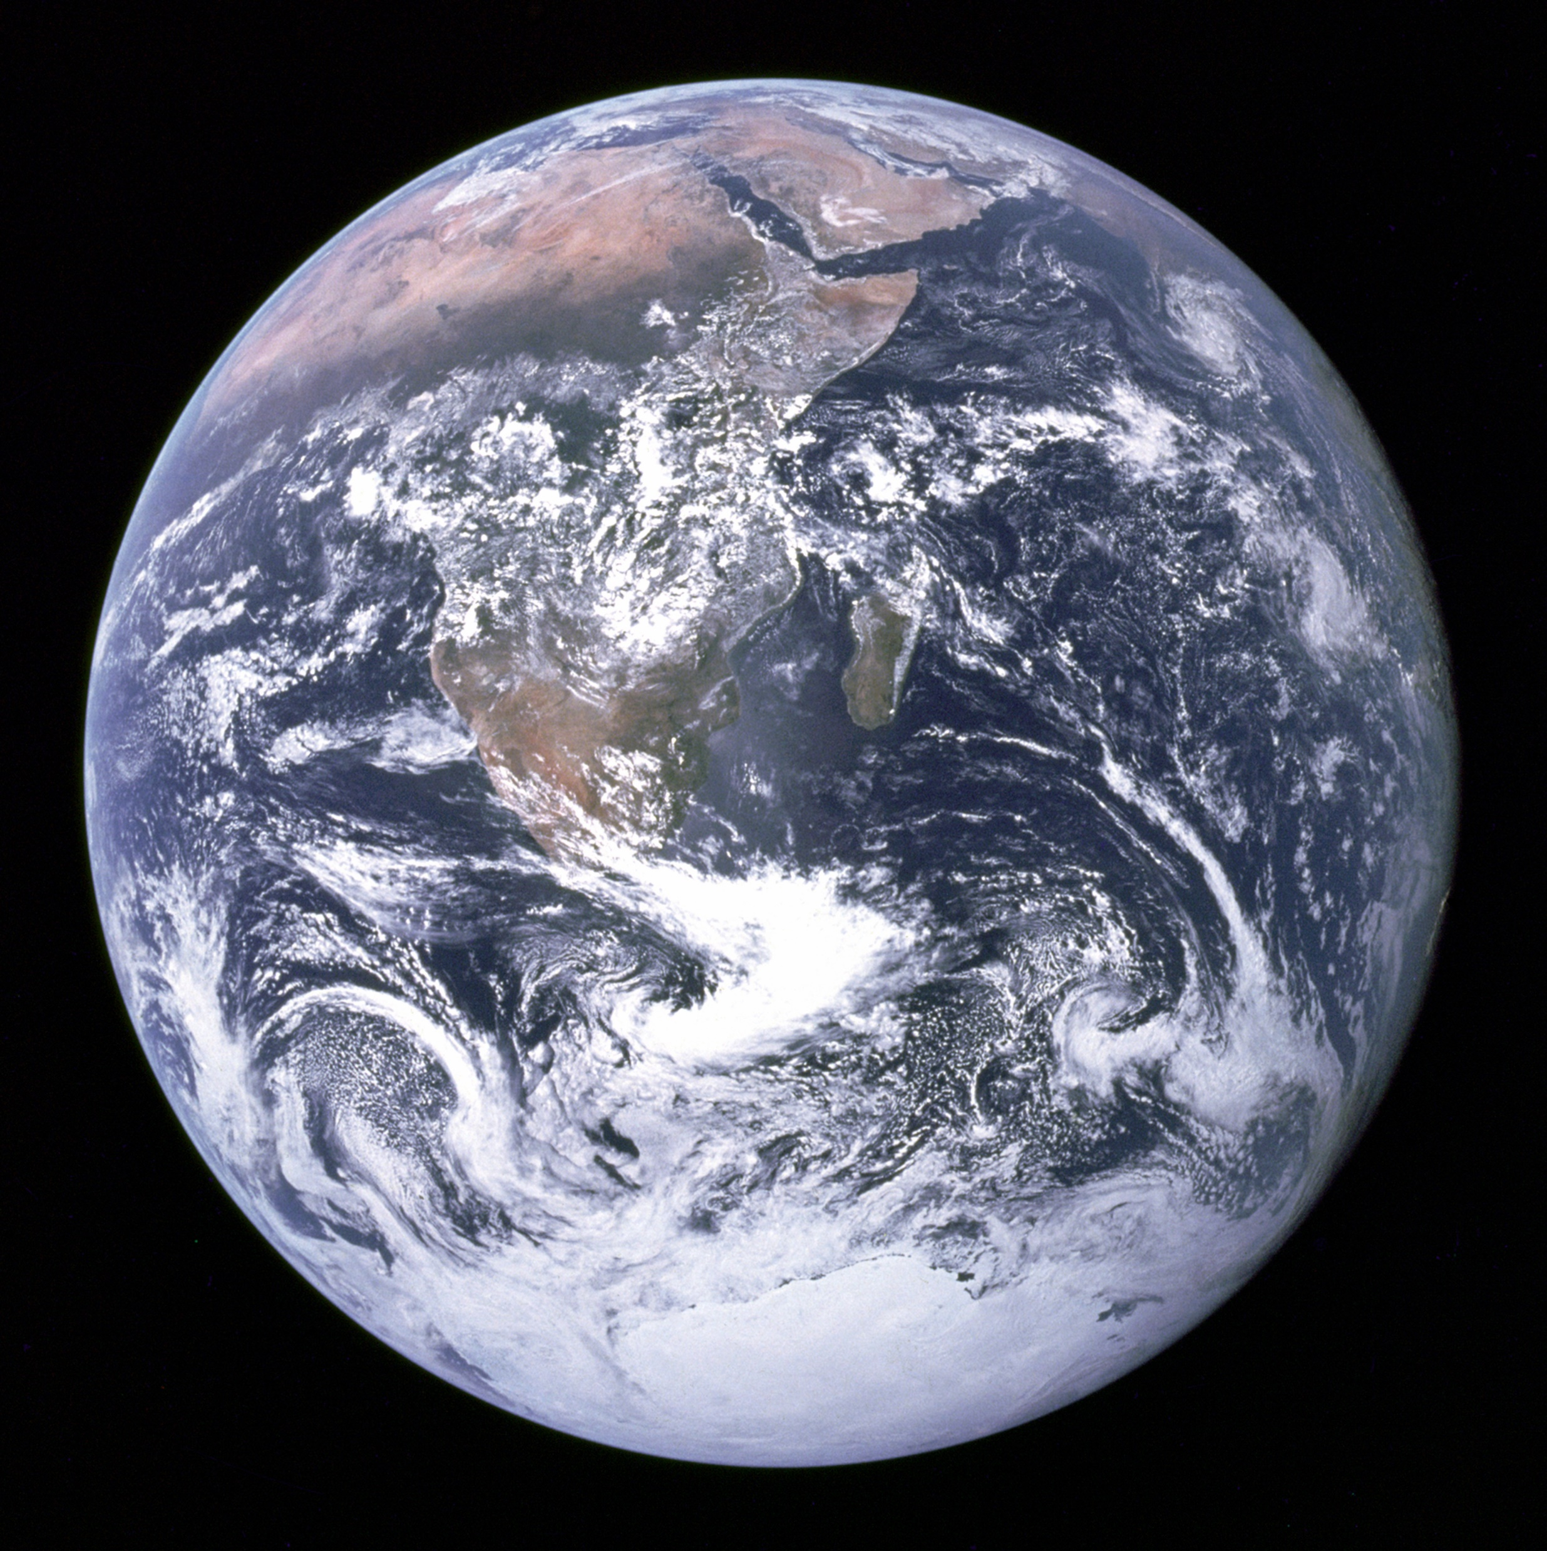
Index
4. Result
Term project topic
5. Conclusion
2. Methodology
6. Reference
3. Data pre-process
7. Ending

Slide 3
1. intro

Slide 4
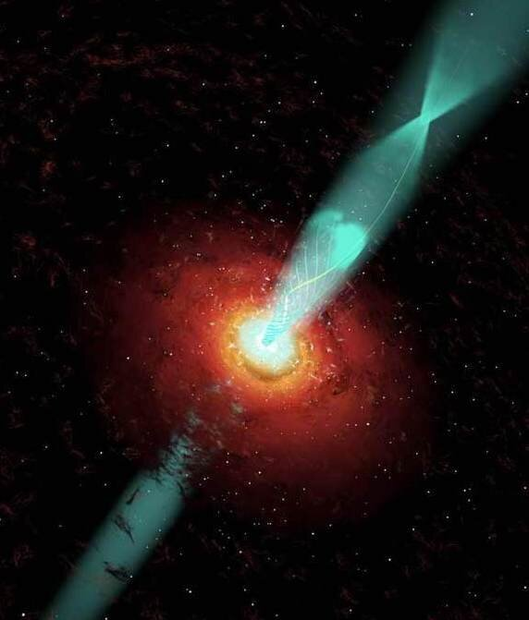
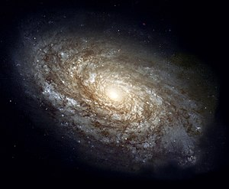
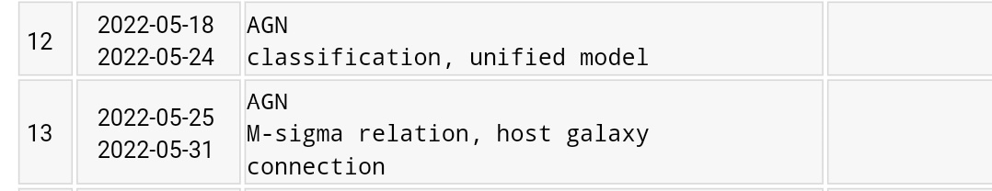
1. Term project topic
VS

Slide 5
2. methodology

Slide 6
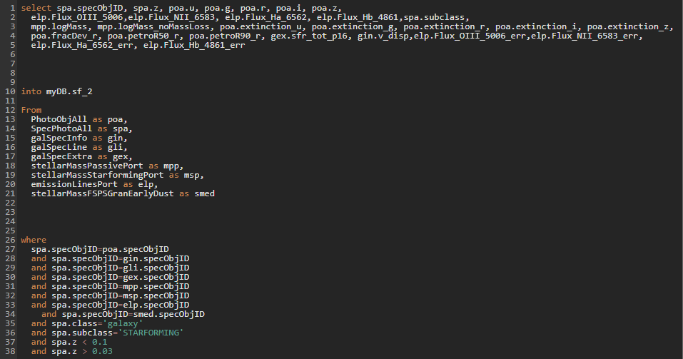
2. Methodology

Slide 7
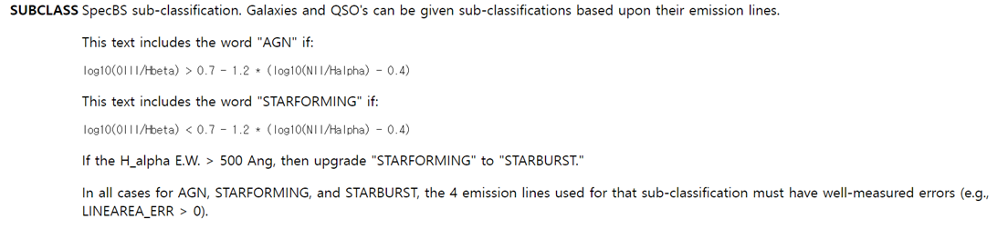
2. Methodology
SDSS SkyServer

Slide 8
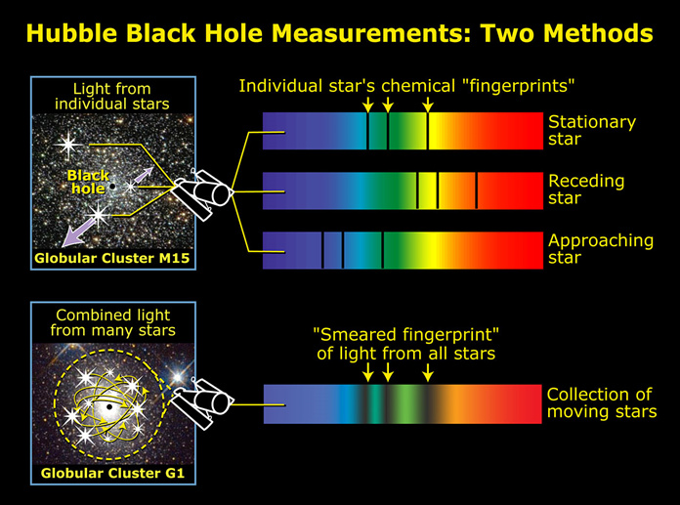
2. Methodology
Eesa, Using spectroscopy to measure velocity dispersion

Slide 9
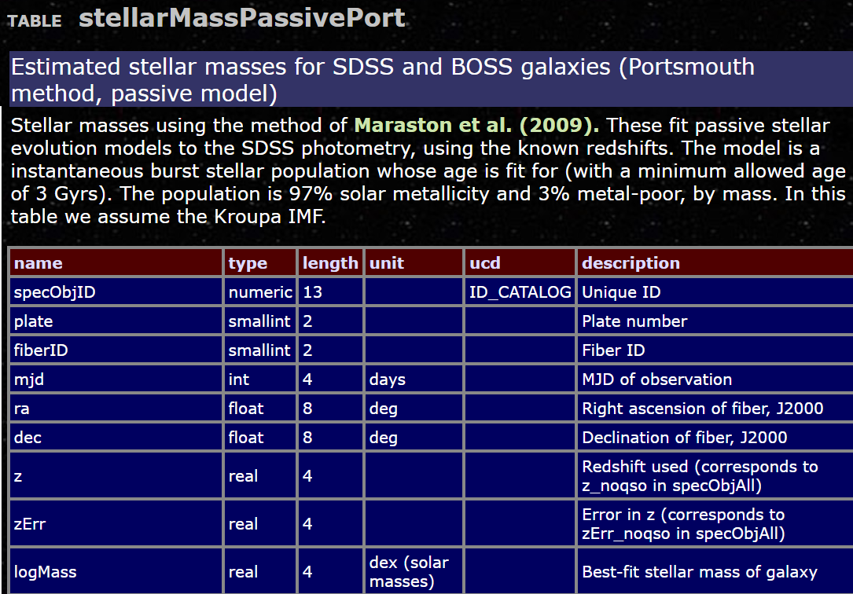
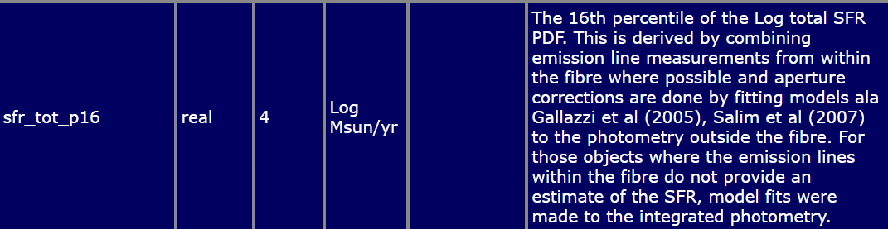
2. Methodology
SDSS, schema

Slide 10
3. Data pre-process

Slide 11
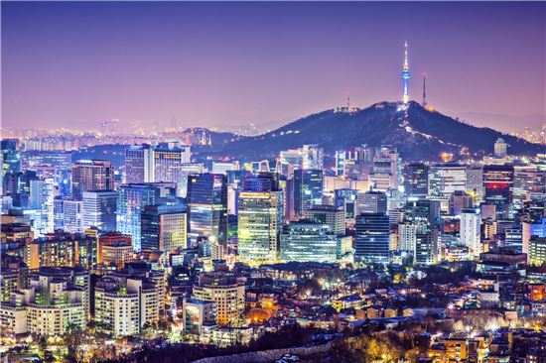
3. Data pre-process -volume limit sampling

Slide 12
3. Data pre-process -volume limit sampling
Close distance
More Bright galaxies detected
Just like that
we can see smaller buildings
In our neighbor region.
Selection Bias

Slide 13
3. Data pre-process -volume limit sampling
Apparent magnitude
What we need?
z
Absolute magnitude
10pc

Slide 14
3. Data pre-process -volume limit sampling
Apparent magnitude
we need
Comoving distance
Transverse comoving distance
Luminosity distance
Pogson’s equation

Slide 15
3. Data pre-process -volume limit sampling
Comoving distance
Transverse comoving distance
Luminosity distance
Pogson’s equation

Slide 16
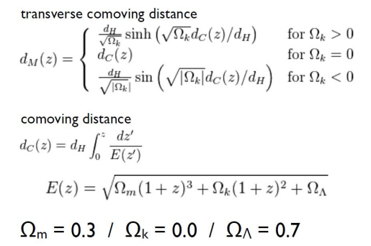
3. Data pre-process -volume limit sampling
Comoving distance
Transverse comoving distance

Slide 17


3. Data pre-process -volume limit sampling
3) Luminosity distance
4) Pogson’s equation
Luminosity distance : $D_{L}\left(z\right)=\left(1+z\right)D_{M}\left(z\right)$
Pogson’s equation : $M_{r}=m_{r}−5\log\left(D_{L} \left(Mpc\right)\right)−25$

Slide 18

3. Data pre-process -volume limit sampling
SDSS absolute magnitude limit :
$M_{r,lim}=17.77−5log⁡(D_{L}\left(Mpc\right))−25$

Slide 19
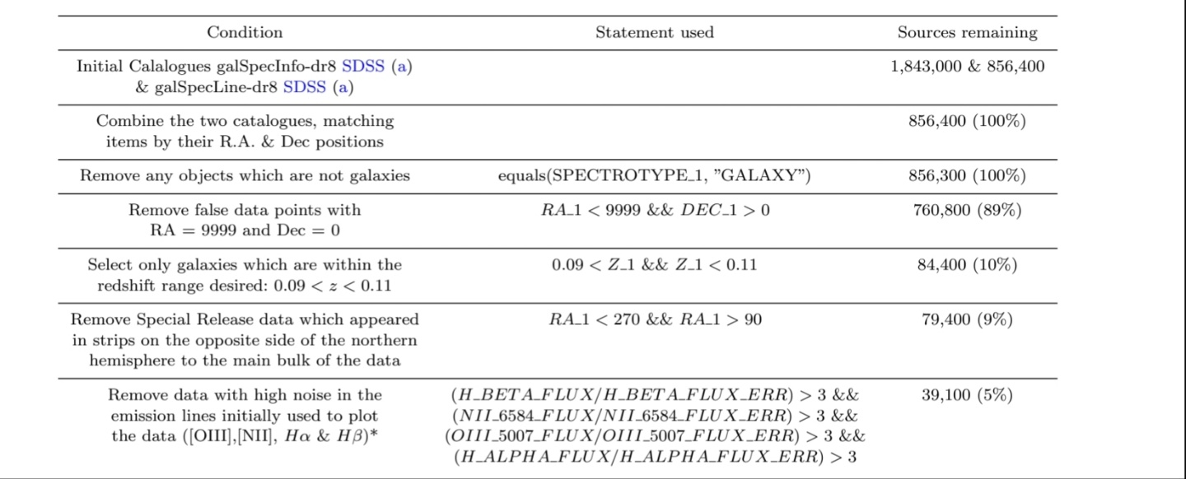
3. Data pre-process – Signal to noise
Charlotte.A et al. 2019.

Slide 20
3. Data pre-process
 | AGN | SF galaxies
Before | 7149 | 132828
After | 4327 | 45682

Slide 21
4. AGN properties

Slide 22
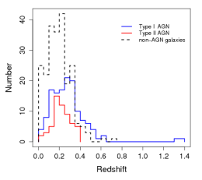
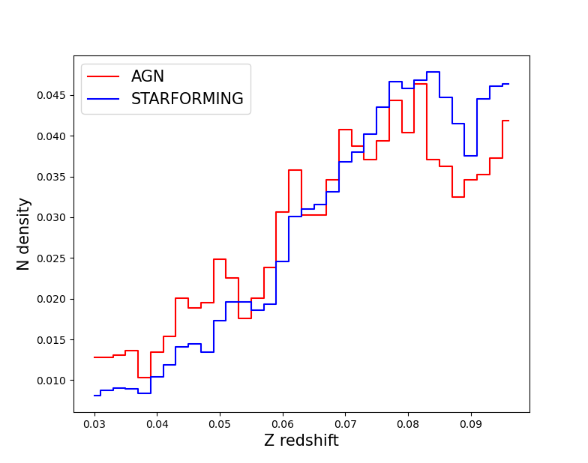
4. Result - Distribution
Frank.J et al. 2010, Astro-ph.CO

Slide 23
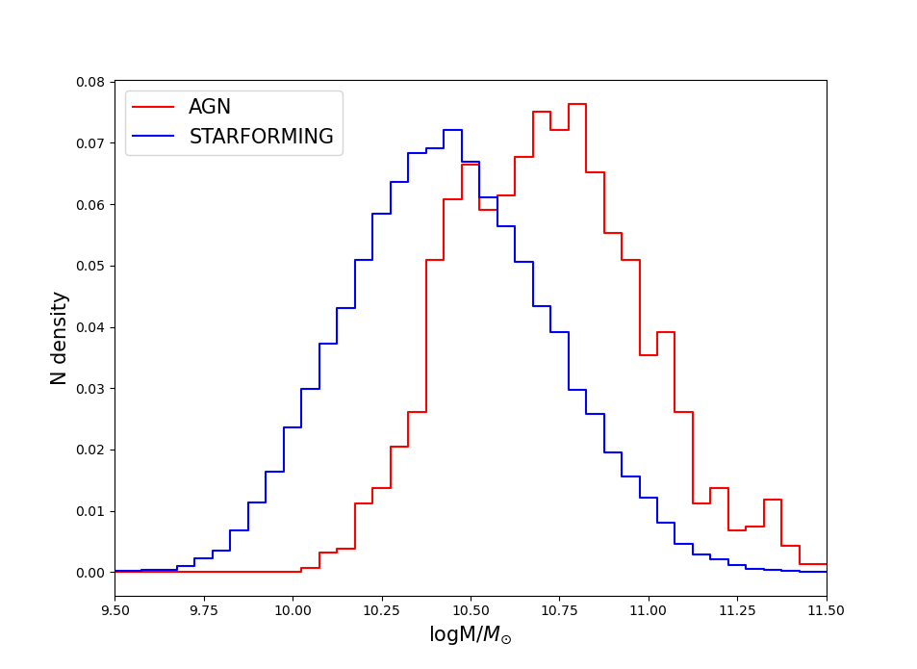
4. Result - Distribution

Slide 24
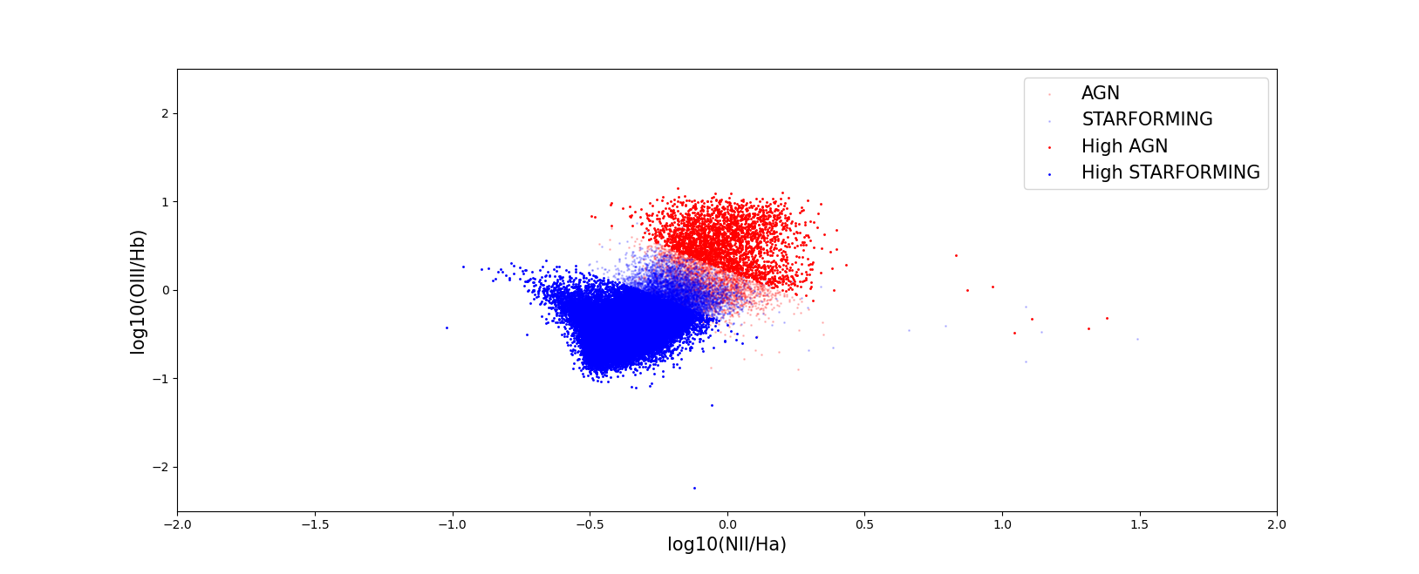
4. Result

Slide 25
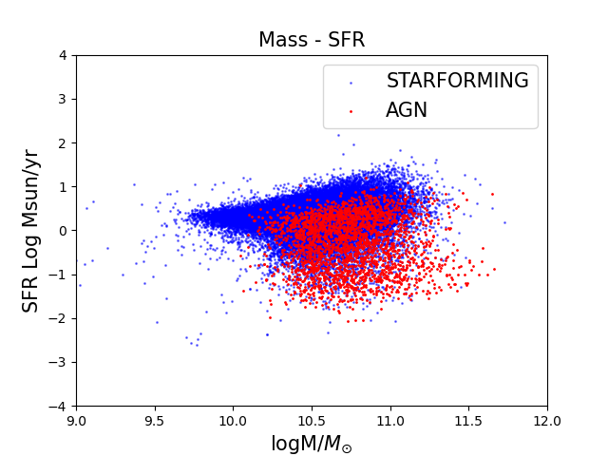
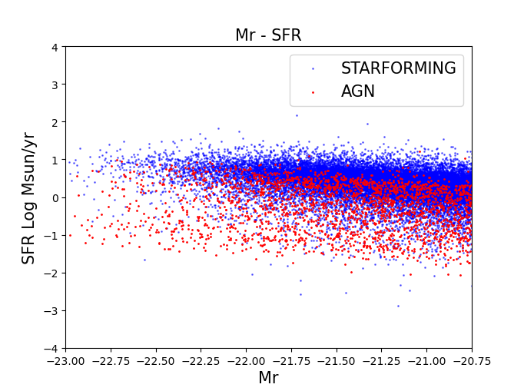
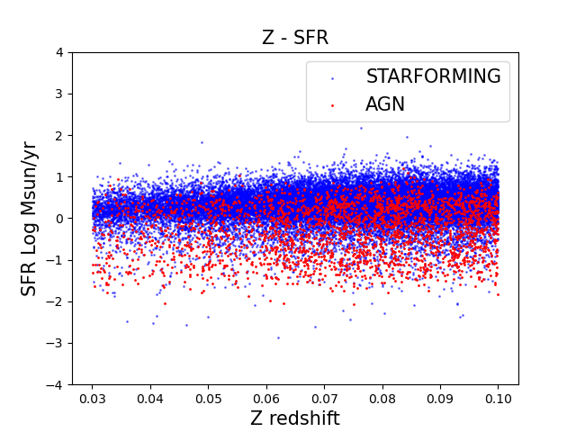
4. Result AGN - SFR

Slide 26
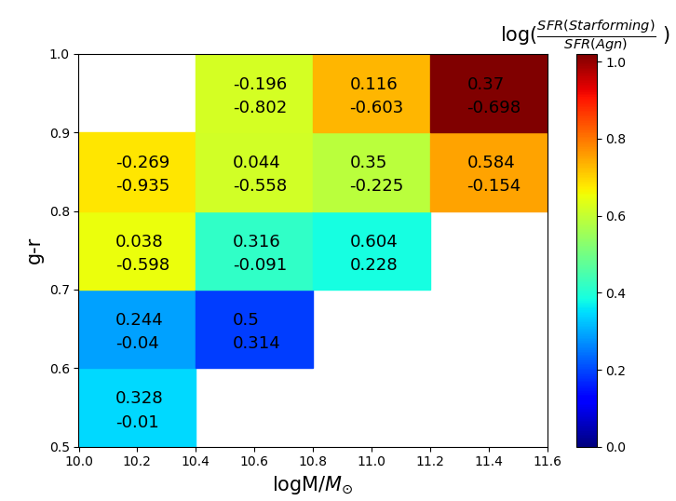
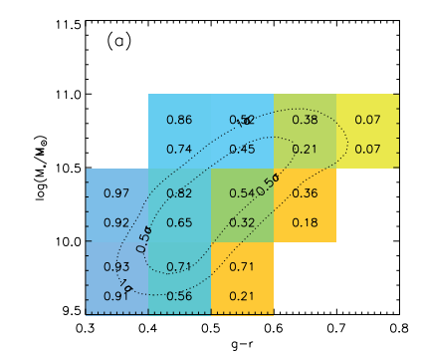
4. Result – AGN - SFR
Oh et al. 2012 ApJS

Slide 27
4. Result – AGN - SFR

Slide 28
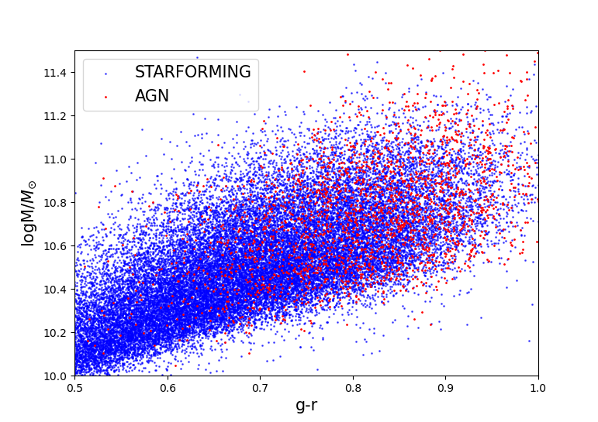
4. Result – AGN - SFR
AGN effect
As Galaxies heavier or redder
the effect of AGN on SFR increases

Slide 29
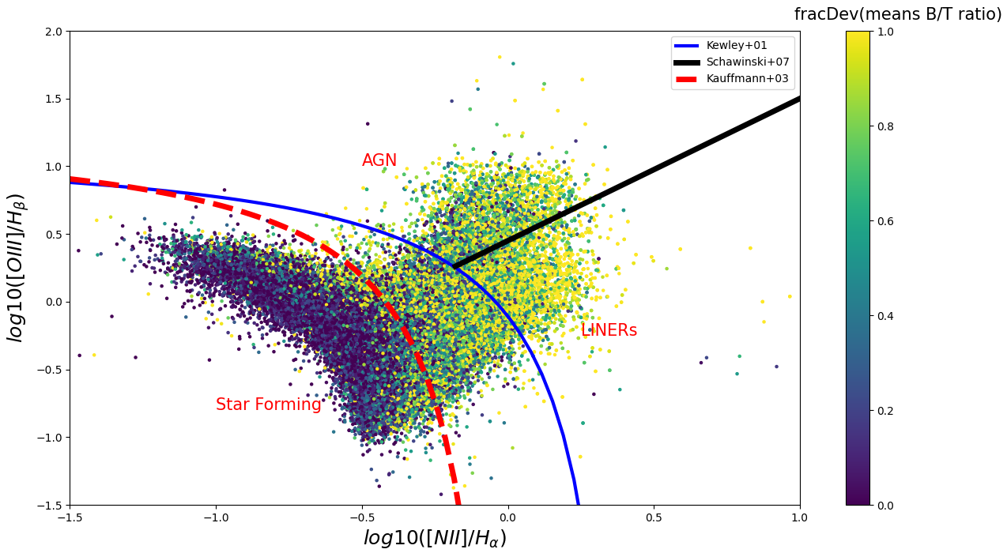
4. Result – BPT diagram

Slide 30
4. Result – BPT diagram
X,Y axis => [OIII] and H alpha / [NII] and H beta
These emission lines are reddening independent
Because they are very close each others.
These diagram shows which effect is dominant AGN? SF?

Slide 31
4. Result – BPT diagram
LINERs classification include the seyfert-like galaxies. Which is famous AGN type.
Classify the samples
fracDev means Bulge to Total ratio
In this project, we classify the AGN and SF
Into two part.
fracDev > 0.7 => Bulge Dominant
fracDev < 0.4 => Disk Dominant
AGN Bulge Dominant | AGN Disk Dominant | SF Bulge Dominant | SF Disk Dominant
3450 | 877 | 14967 | 30715

Slide 32
4. Result – Colour-Colour diagram
We chose g-r for x axis, u-r for y axis.
We expected AGN is redder than SG galaxies so AGN would locate right under position.
so we assume that CC-diagram would show linear relation.

Slide 33
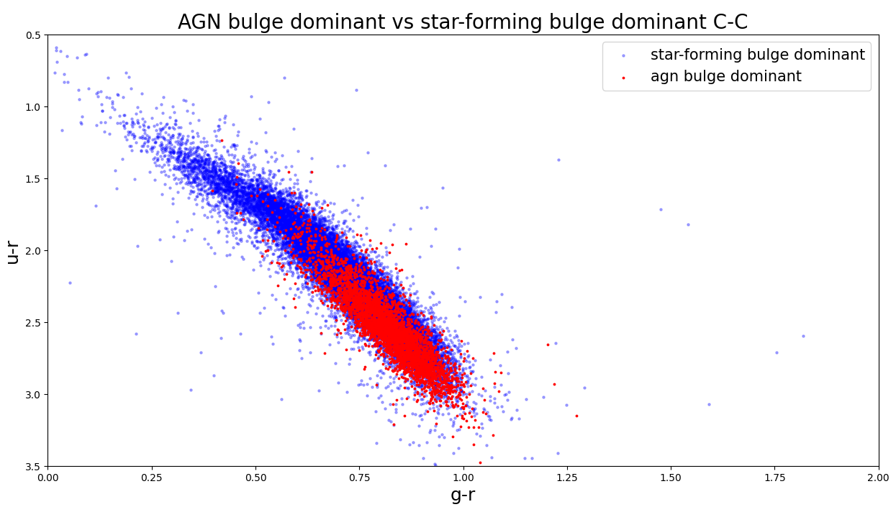
4. Result – Colour-Colour diagram

Slide 34
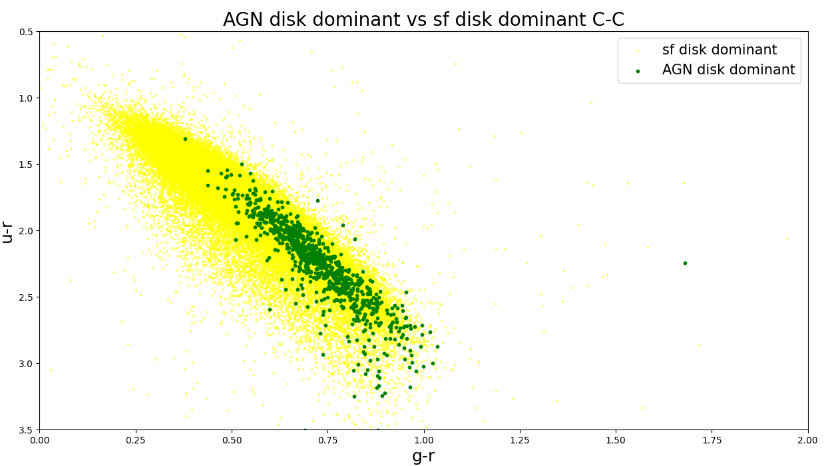
4. Result – Colour-Colour diagram

Slide 35
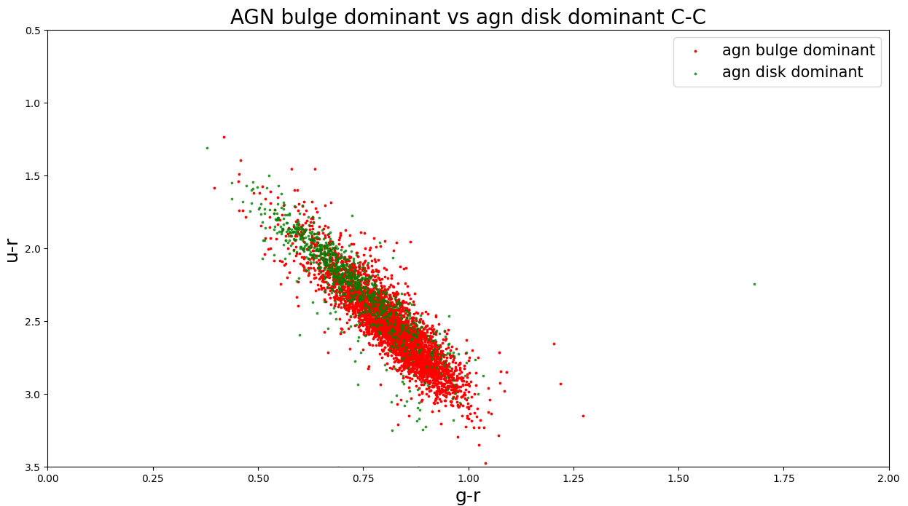
4. Result – Colour-Colour diagram

Slide 36
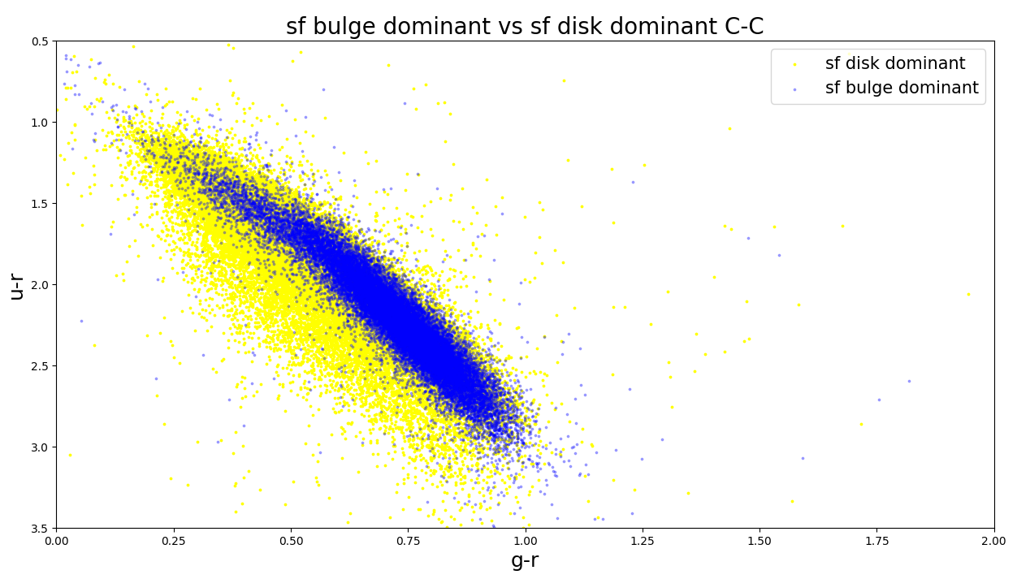
4. Result – Colour-Colour diagram

Slide 37
4. Result – Colour-Colour diagram
Linear relation
on CC diagram
Compare
1) AGN VS SF
2) Bulge dominant
vs
Disk dominant

Slide 38
4. Result – Colour-Magnitude diagram
We expected AGN is located in redder part, which is above the SF galaxies.
AGN’s property : very bright
This feature would make AGN distribution shift to left side.

Slide 39
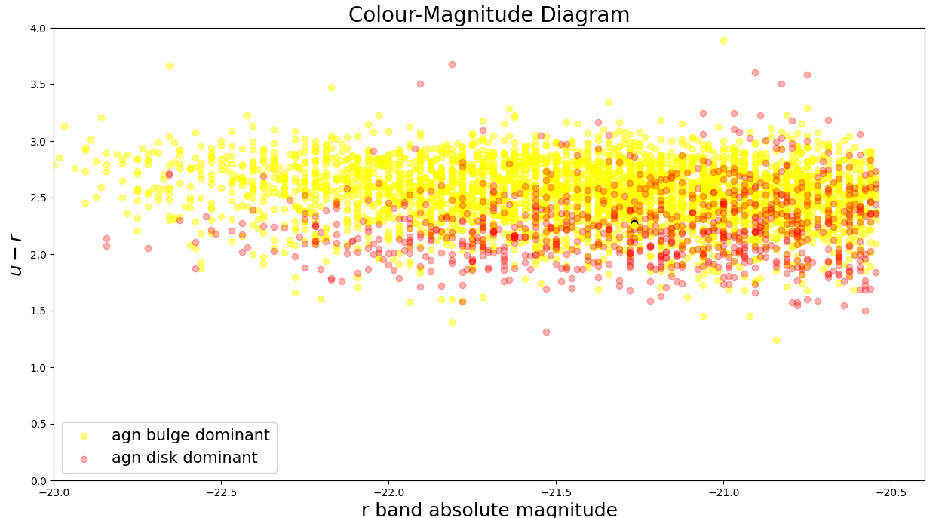
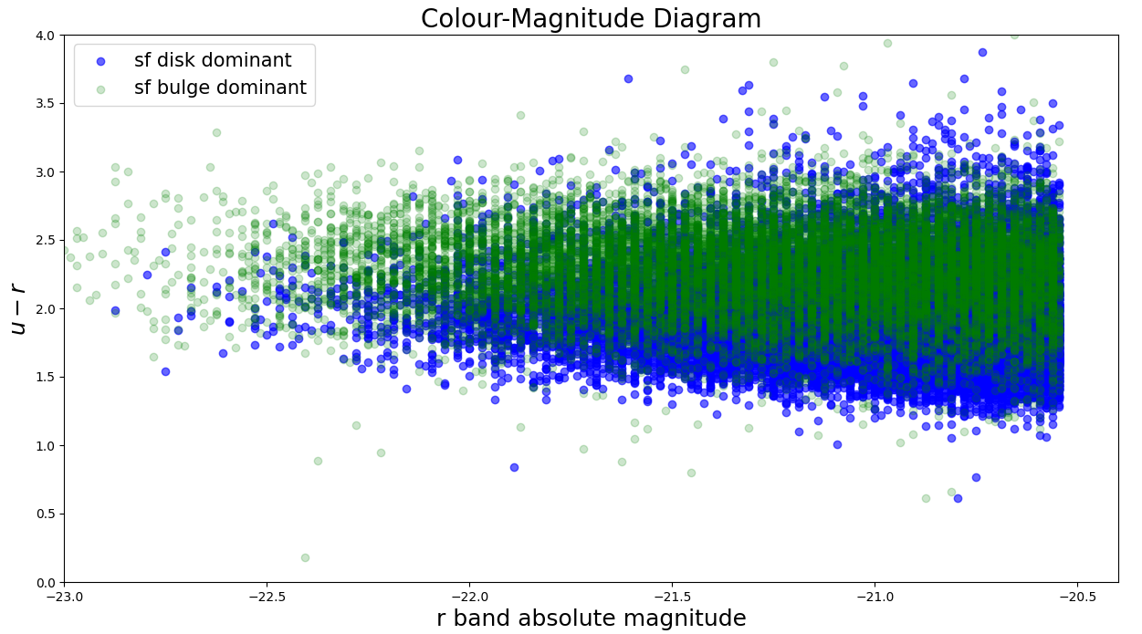
4. Result – Colour-Magnitude diagram

Slide 40
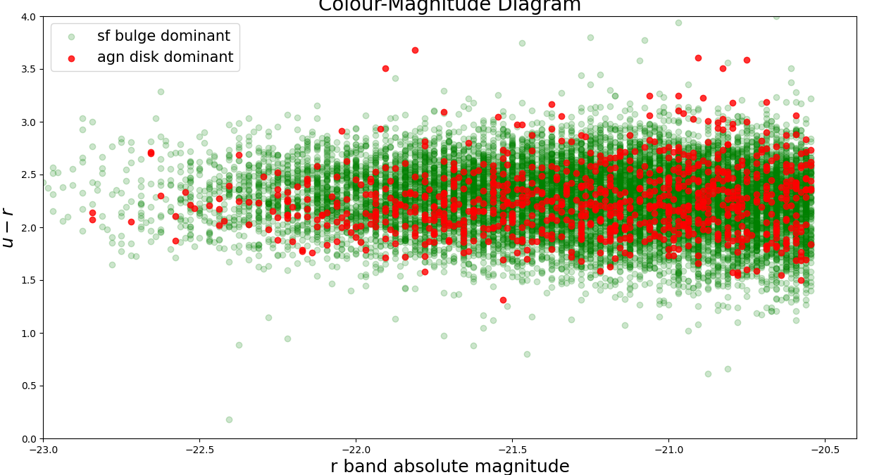
4. Result – Colour-Magnitude diagram

Slide 41
4. Result – Colour-Magnitude diagram
Overall, AGN is little bit redder than SF galaxies.
Comparing to Bulge dominant SF galaxies, AGN Disk dominant galaxies’ colour is almost similar and brighter.(but redder)
=> AGN green valley
Colour-Magnitude Diagram

Slide 42
4. Result – Mass – Velocity dispersion
During this semester, we learned about the relation of velocity dispersion with potential well.
By assuming of virial theorem, Velocity dispersion leads us to the dynamical mass of galaxies.
So we could guess
“velocity dispersion would have linear relation with mass”

Slide 43
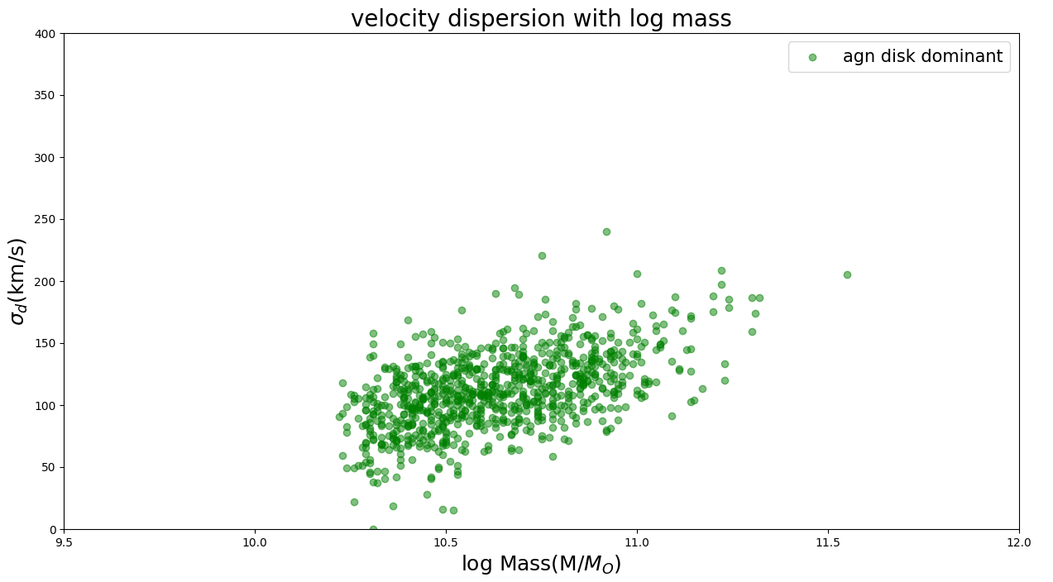
4. Result – Mass – Velocity dispersion

Slide 44
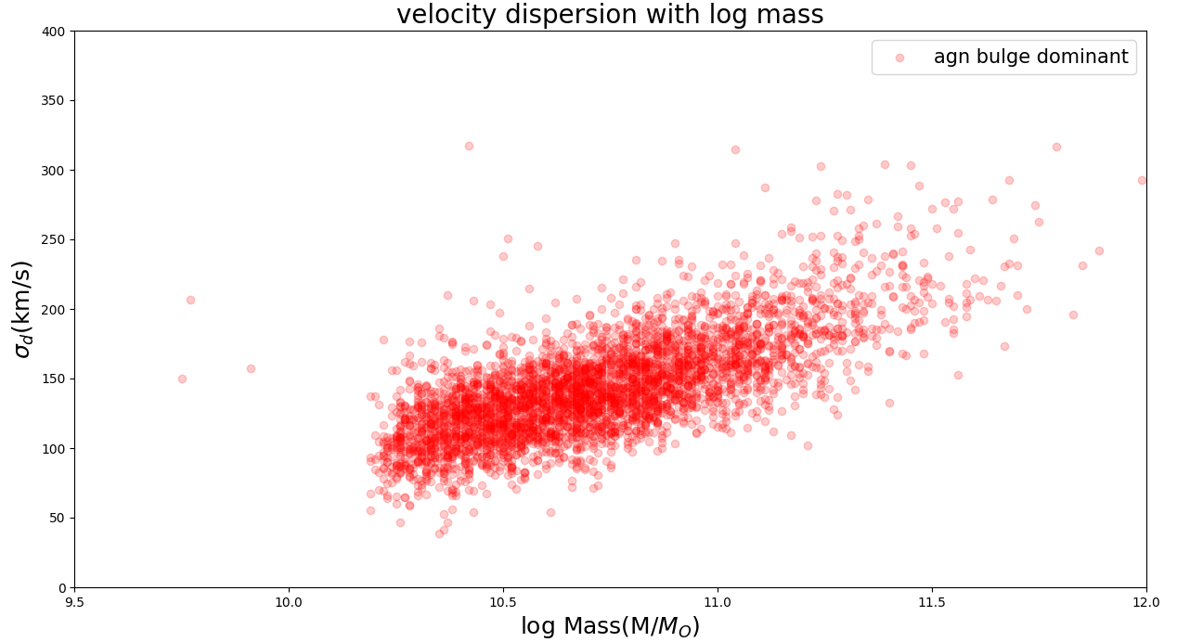
4. Result – Mass – Velocity dispersion

Slide 45
4. Result – Mass – Velocity dispersion
During the semester, We learned that “the velocity dispersion” is related to “the potential well”.
This graph shows that the heavier AGN have larger velocity dispersion(linear relation), which is well matched result with the lecture.

Slide 46
4. Result – Mass-H alpha
We thought ‘if there are same specific star-forming rate then the star forming rate would increase when the mass increases.’ .
And the H alpha line is the one of the most important emission line to check the star-forming rates so we thought there would be some linear relation or distribution exist.

Slide 47
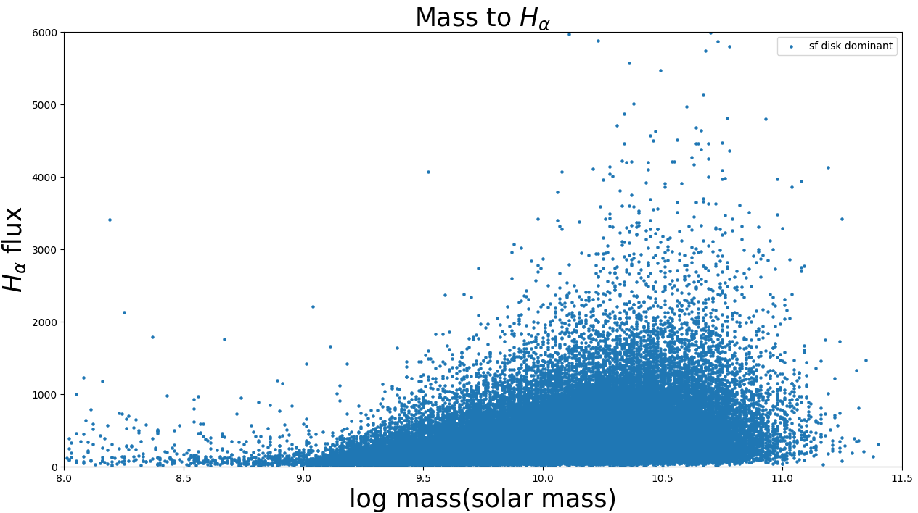
4. Result – Mass-H alpha

Slide 48
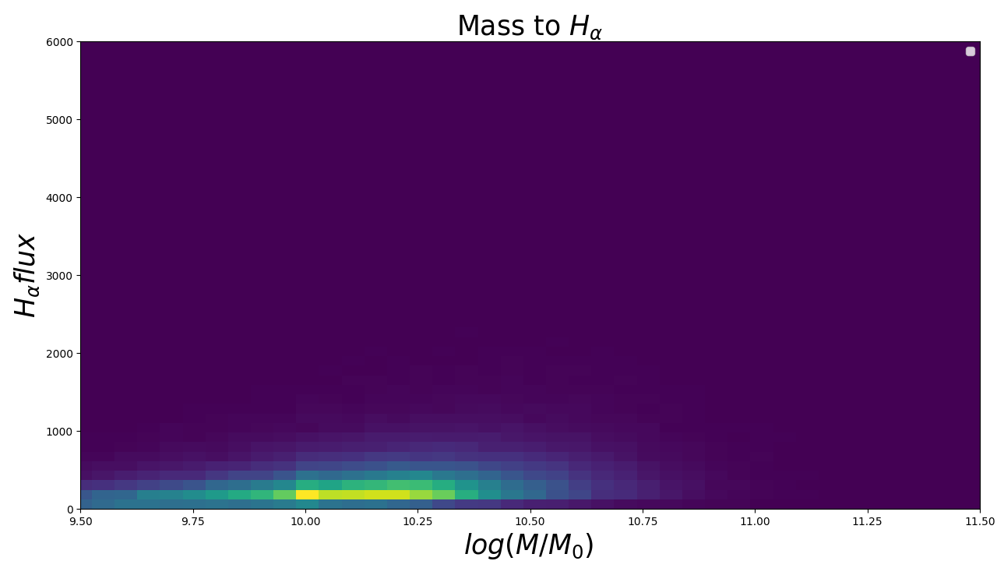
4. Result – Mass-H alpha 2D hist

Slide 49
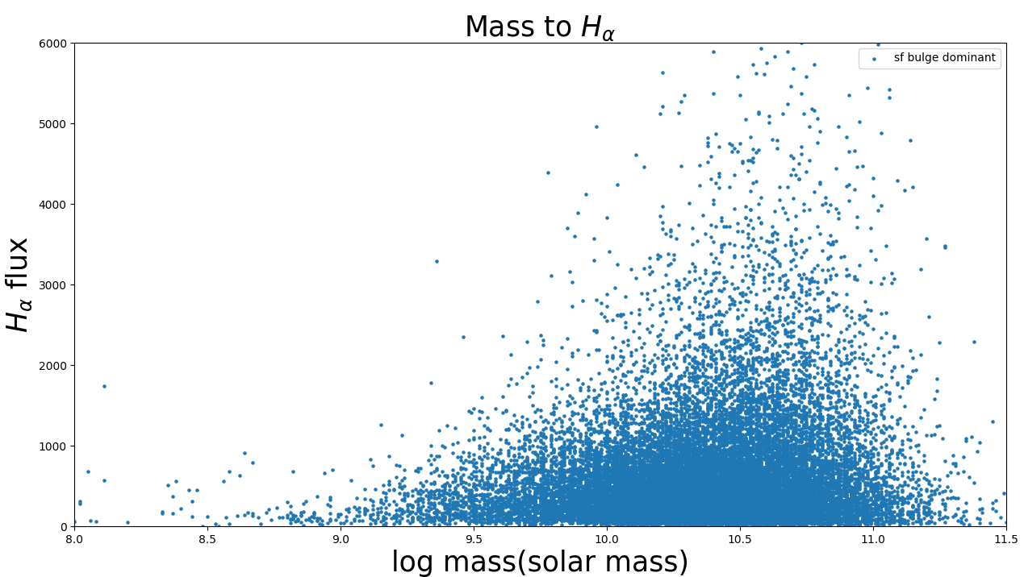
4. Result – Mass-H alpha

Slide 50
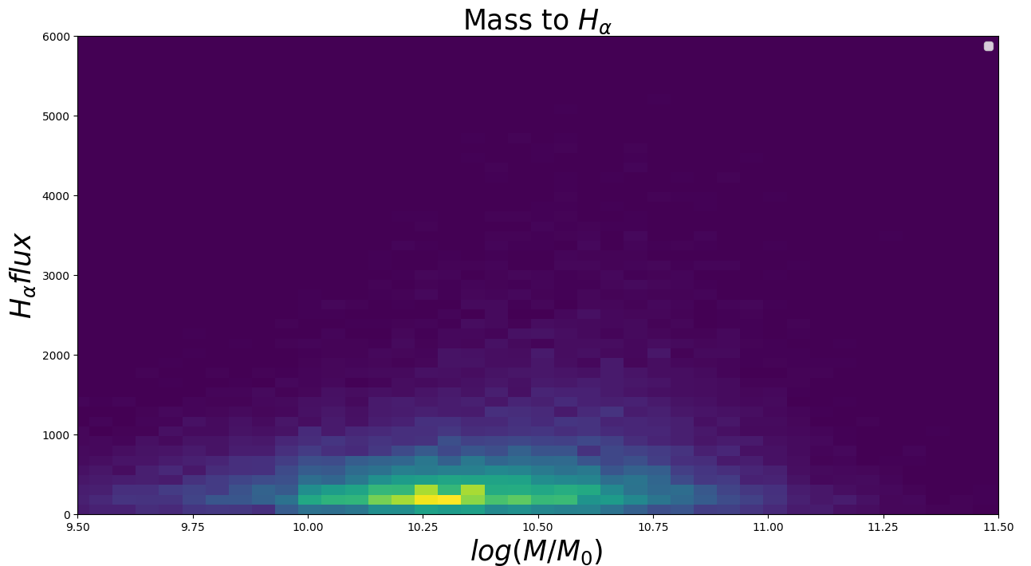
4. Result – Mass-H alpha 2D hist

Slide 51
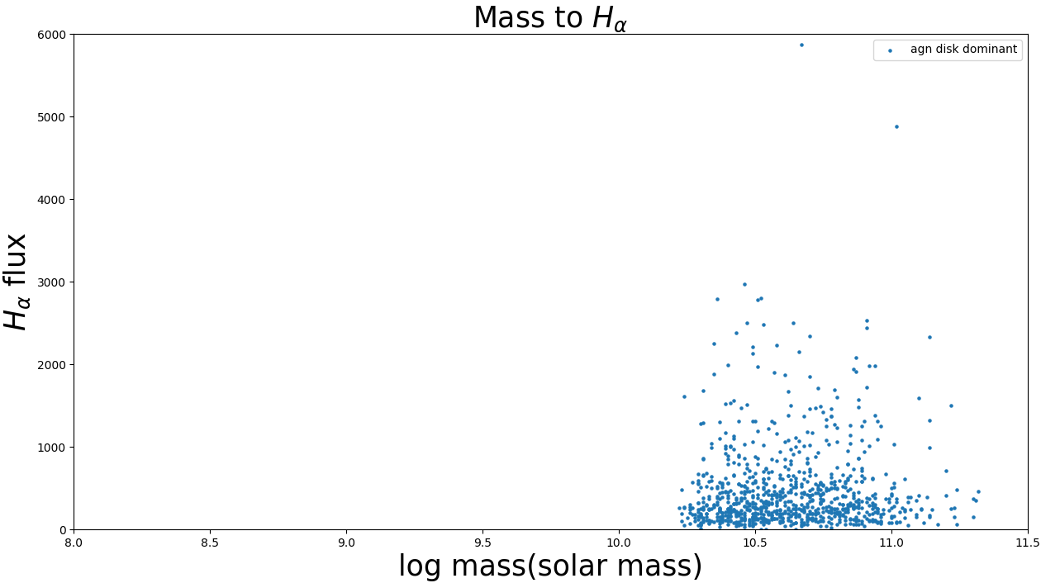
4. Result – Mass-H alpha

Slide 52
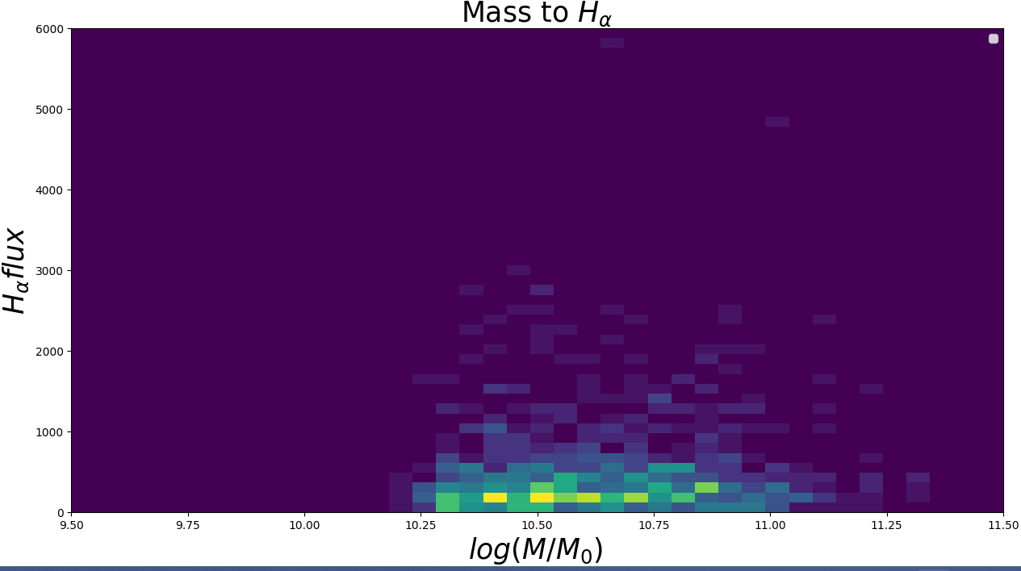
4. Result – Mass-H alpha 2D hist

Slide 53
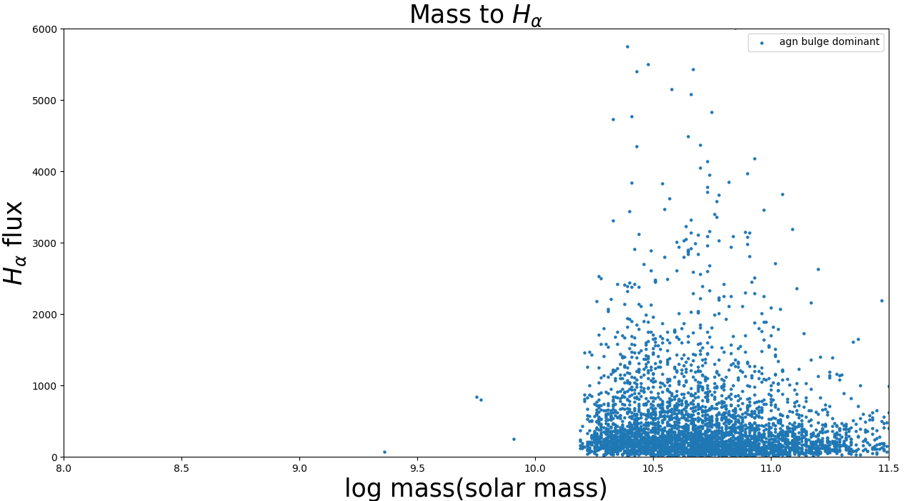
4. Result – Mass-H alpha

Slide 54
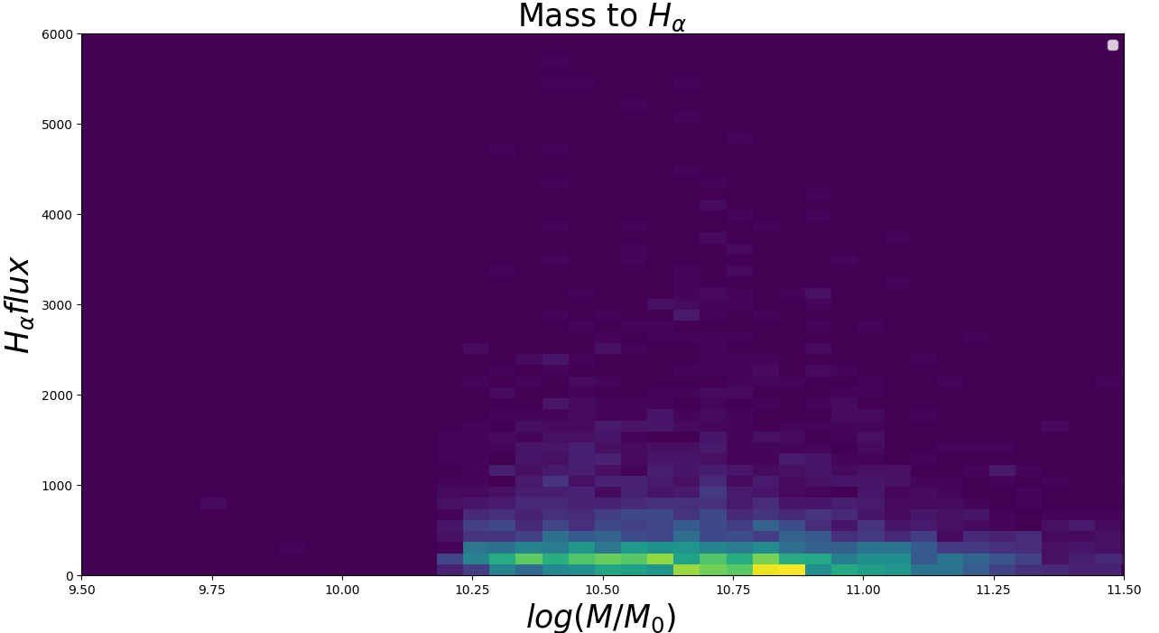
4. Result – Mass-H alpha 2D hist

Slide 55
4. Result – Mass-H alpha 2D hist
Comparing AGN and SF
AGN Mass is larger than SF -> 3~10 times heavier.
SF galaxies are little bit brighter in H alpha range.

Slide 56
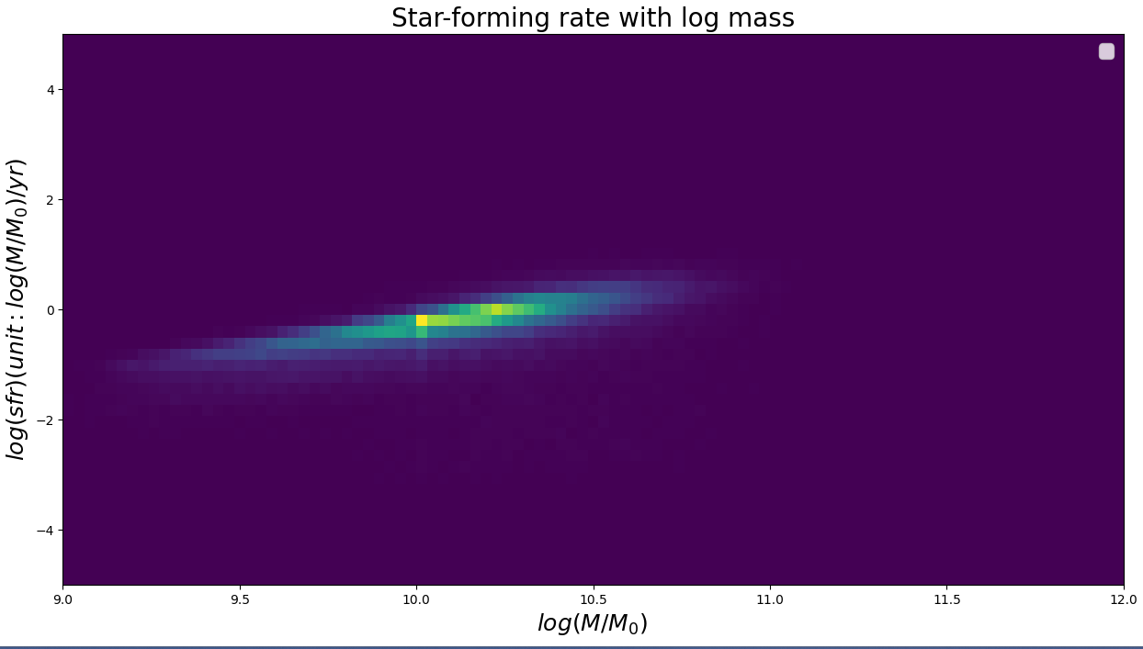
4. Result – Mass – SFR Diagram

Slide 57
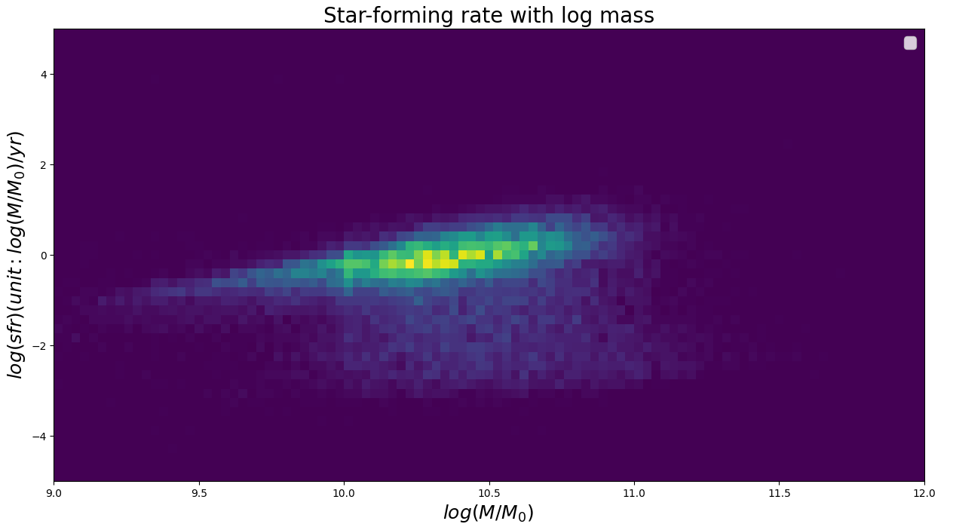
4. Result – Mass – SFR Diagram

Slide 58
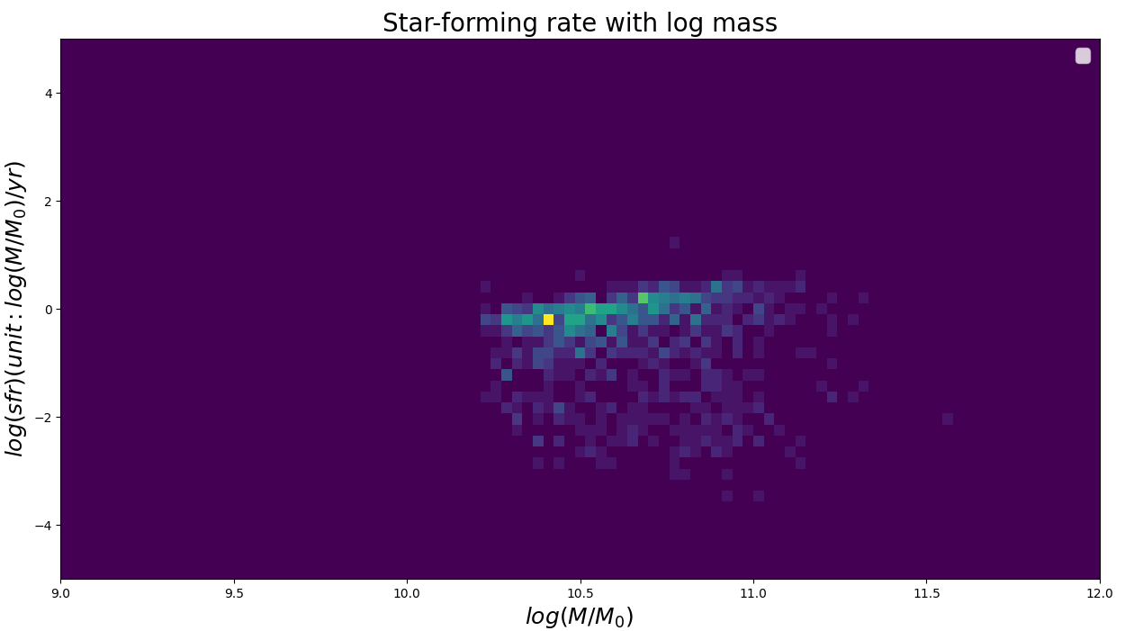
4. Result – Mass – SFR Diagram

Slide 59
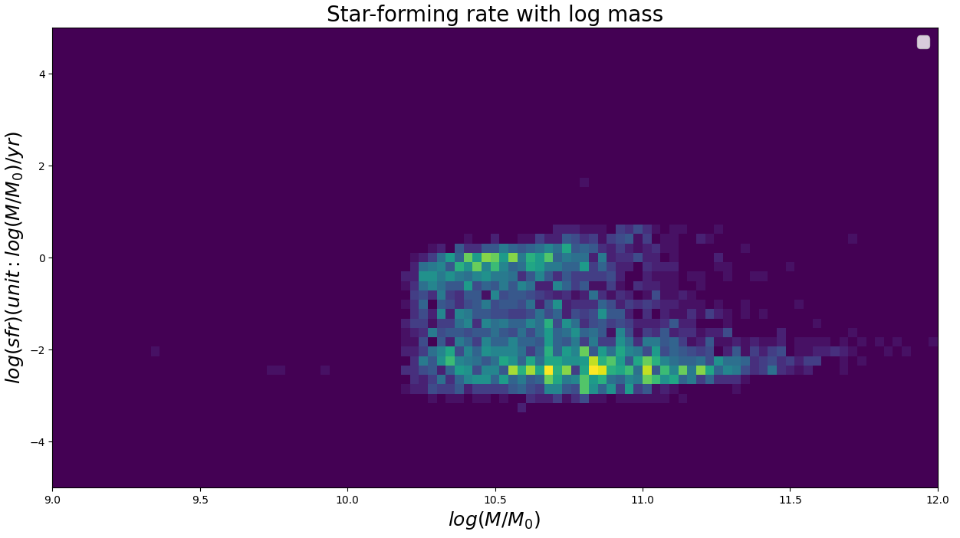
4. Result – Mass – SFR Diagram

Slide 60
4. Result – Mass - SFR Diagram
SFR/mass
Specific sfr
Mass increases
sfr increases

Slide 61
5. Conclusion

Slide 62
5. Conclusion
We learned about AGN properties in undergraduate curriculum.
So we thought AGN would show heavy, bright, red and suppressed SFR properties.
2. AGN and SF both shows gaussian distribution about mass, but AGN is heavier.
3. By BPT diagram, AGN shows high ratio of [OIII], [NII].
4. By Colour-colour diagram, AGN and Bulge dominant shows redder colour result.
5. By Colour-Magnitude diagram, AGN shows brighter and similar but redder colour.
6. By velocity dispersion with log mass diagram, heavier galaxies shows faster velocity dispersion.
7. We could not find some relation between H alpha and log mass
8. Meanwhile, SFR increase when log mass increases.

Slide 63
5. Conclusion
We learned about AGN properties in undergraduate curriculum.
So we thought AGN would show heavy, bright, red and suppressed SFR properties.

Slide 64
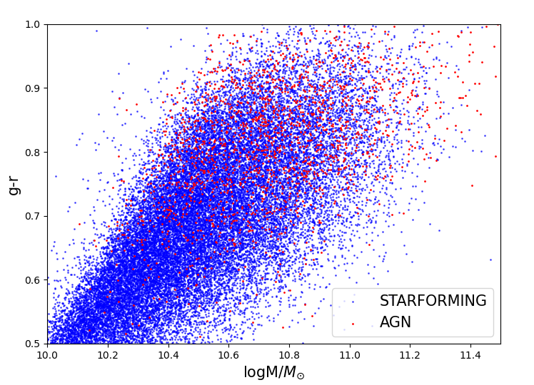
5. Conclusion
We learned about AGN properties in undergraduate curriculum.
So we thought AGN would show heavy, bright, red and suppressed SFR properties.

Slide 65
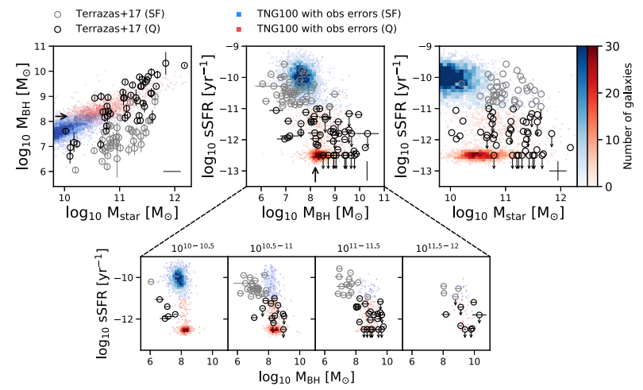
5. Conclusion
We learned about AGN properties in undergraduate curriculum.
So we thought AGN would show heavy, bright, red and suppressed SFR properties.
Terrazas et al.2020
Energic momentum AGN feedback

Slide 66
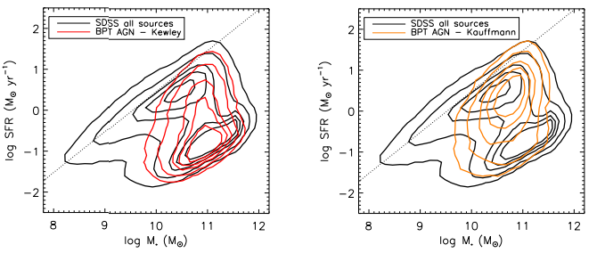
5. Conclusion
We learned about AGN properties in undergraduate curriculum.
So we thought AGN would show heavy, bright, red and suppressed SFR properties.
SF late
SF early
Alison.L.Coil et al. 2007
AGN late
AGN early

Slide 67
5. Conclusion
2. AGN and SF both shows gaussian distribution about mass, but AGN is heavier.

Slide 68
5. Conclusion
3. By BPT diagram, AGN shows high ratio of [OIII], [NII].
[OIII], [NII] forbidden line is strong in the
AGN environment.
And H Balmer lines is enhanced by the SF.
By the Kewley et al.2001,
Kauffmann et al. 2003,
schawinski et al.2007, BPT diagram can be
devide in to three parts.
AGN shows relatively low SF effect comparing
To AGN emission effect.

Slide 69
5. Conclusion
4. By Colour-colour diagram, AGN and Bulge dominant shows redder colour result.
Between AGN and SF galaxies,
AGN is redder than SF galaxies.
Between the Disk and Bulge dominant,
Bulge dominant galaxies are redder
than the other.

Slide 70
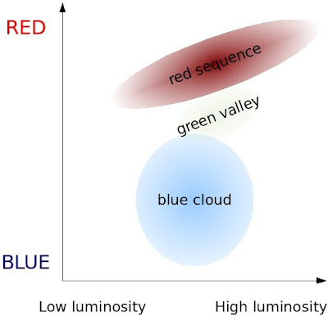
5. Conclusion
5. By Colour-Magnitude diagram, AGN shows brighter and redder colour.
For the AGN groups, They located in the upper
Side of SF galaxies but that difference is not so
Big -> AGN is located in “the green valley”.
For the AGN spiral dominant galaxies,
The colour is very similar with SF galaxies and brighter.
Wong et al.2012

Slide 71
5. Conclusion
6. By velocity dispersion with log mass diagram, heavier galaxies shows faster velocity dispersion.
8. Meanwhile, SFR increase when log mass increases.

Slide 72
5. Conclusion
6. By velocity dispersion with log mass diagram, heavier galaxies shows faster velocity dispersion.
8. Meanwhile, SFR increase when log mass increases.
Guess : High velocity dispersion => High log mass
=> high Black hole Mass with gas accretion => by AGN feedback, SF must be suppressed.
But, By sfr-log mass diagram, SFR increase when Mass increased.
This is different result with upper claim.

Slide 73
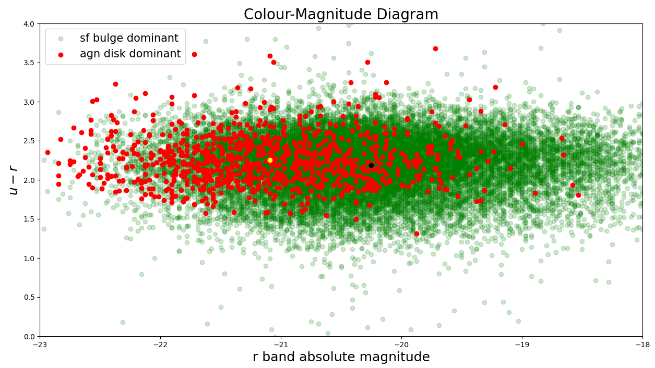
5. Conclusion - summary
We guess, AGN was the star-forming galaxies. This assumption can explain the number with log mass
And the high brightness in r band.

Slide 74
5. Conclusion - summary
The high flux of forbidden lines such as [OIII], [NII] means the AGN activity is dominant compare to the sf effect,
By the relation of velocity dispersion with mass and stellar mass with Black hole mass, and the last
High Blackhole mass suppress the sf by the AGN energy feedback.

Slide 75
5. Conclusion - Summary
AGN would have high sfr and mass increasing in the past.
So the AGN is heavier than SF galaxies.
the SFR was too high so that the red and old galaxies dominant in the luminosity and colour.
And after the SFR by the AGN nuclei, AGN feedback would make the sfr lower and large galaxy
Have the large black holes (by the mass increasing?) which is the strong AGN feedback.

Slide 76



5. Conclusion - summary
Martin-Navarro et al.2022

Slide 77
6. reference

Slide 78
6. Reference
Martin-Navarro, I et al, 2022, MNRAS, Vol 513,pages L10-L14.
NASA; M. Weiss/CfA
V. Smolčić, 2009, ApJ
Ho,Luis C et al, 1993, AJ, v.417,p63
J.A.Baldwin et al, 1981, ASP, v 93, No.551
Alison L.Coil et al, 2007, ApJ
C.McPartland et al, 2019, MNRAS, Vol 482, pages L129-L133
Ellison, Sara L et al, 2011, MNRAS, Vol418, pages 2043-2053
Charlotte. A et al, 2019, NLUA, 1, 59-74
Wong et al, “Galaxy Zoo: building the low-mass end of the red sequence with local post-starburst galaxies”,2012.
Baldwin.J.A, 1981, ASP, vol 93, p 5-19
Terrazas et al.2020, MNRAS, vol 493, pages 1888-1906
Kewley et al.2001, ApJL, 774, L10
Kauffmann et al. 2003, MNRAS, vol 346, pages 1055-1077
schawinski et al.2007, MNRAS, vol 382, pages 1415-1431
SeulHee.Oh et al, 2018.
R.J.Smethurst et al, 2016.
Y.Q.Xue et al, 2014, ApJ
G.Mountrichas et al, 2022, A&A.
S.F.Sanchez et al, 2018, Revisit Mexicana de Astronomia y astrofisica, 54, 217-260
Eesa, Using spectroscopy to measure velocity dispersion
Gallazzi et al, 2005
Salim et al, 2007
Maraston et al, 2009

Slide 79
Thank you

